Slide 1
Movie Recommendation System
Group 5 - Tech Titans
NAME | ENROLLMENT NO
JAINAM R SHAH | AU2040186
YASH CHOTALIYA | AU2040193
AKSHAY PARMAR | AU2040199
SHUBHAM BHATT | AU2040206

Slide 2
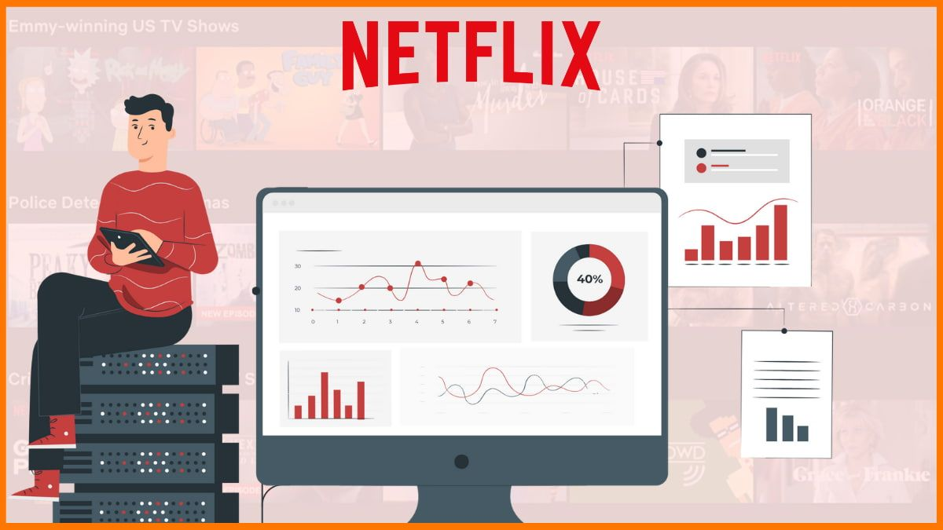

Introduction
Movie recommendation systems analyse user preferences and interaction data using machine learning algorithms, then utilise the results to personalise suggestions for movies that viewers are likely to enjoy.
In this project, we will see how collaborative filtering could be used to create a movie recommendation system that can provide viewers personalised suggestions based on their viewing history and behaviour.
[1] Wu, C. S. M., Garg, D., & Bhandary, U. (2018, November). Movie recommendation system using collaborative filtering. In 2018 IEEE 9th International Conference on Software Engineering and Service Science (ICSESS) (pp. 11-15). IEEE.

Slide 3
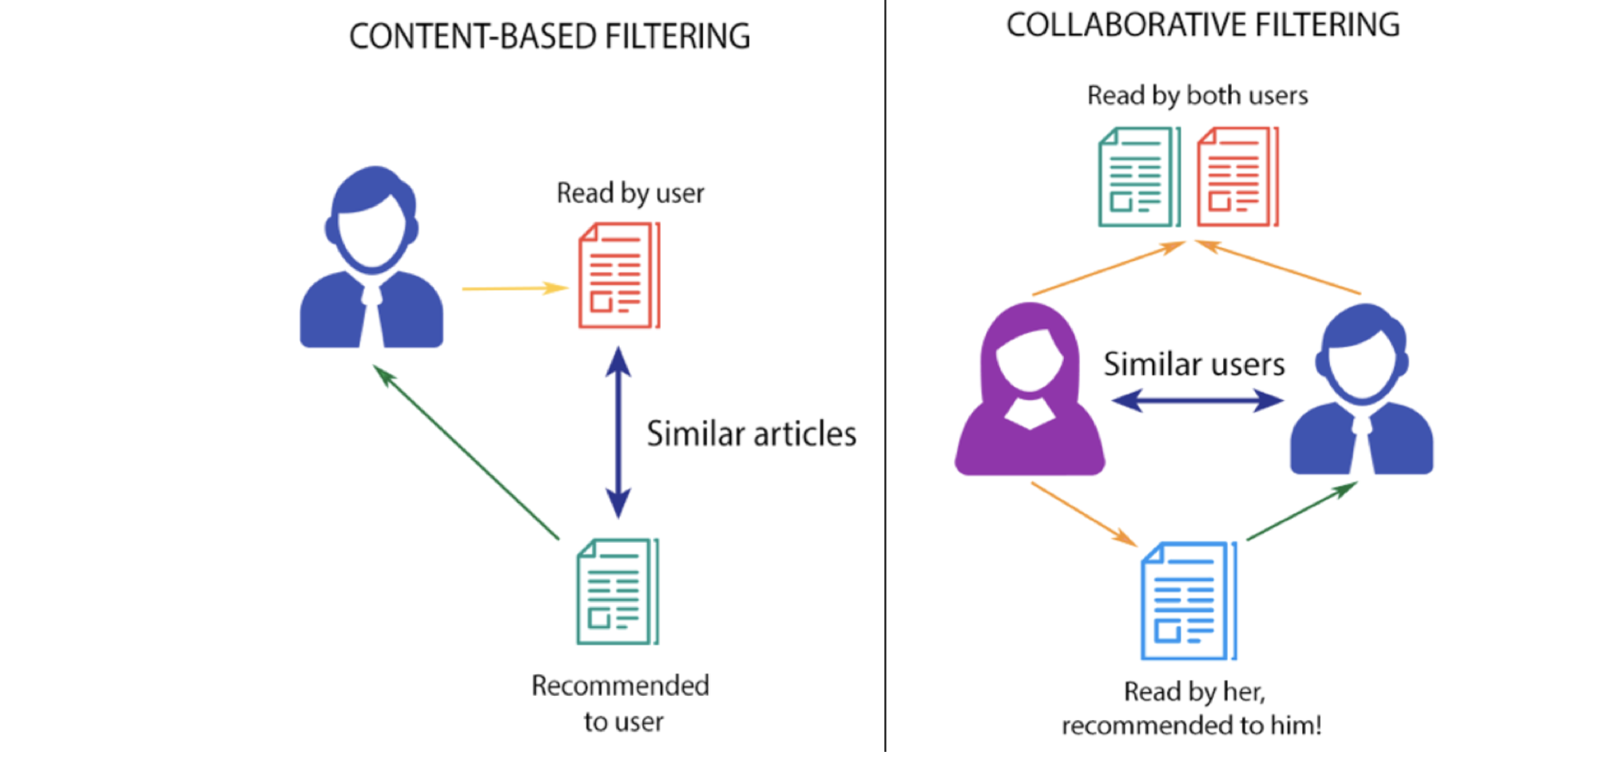
Problem Statement
The problem statement for this project is to build a movie recommendation system using user based collaborative filtering.
Why collaborative filtering?
In content and item based algorithm, recommendation is happening based on history of user but in collaborative filtering we are recommending the movie based on user ratings.
Based on user preferences, movie ratings, and other relevant information to this system will identify similar user.
User similarity system will be used by a system to recommend a movie.
[1] Wu, C. S. M., Garg, D., & Bhandary, U. (2018, November). Movie recommendation system using collaborative filtering. In 2018 IEEE 9th International Conference on Software Engineering and Service Science (ICSESS) (pp. 11-15). IEEE.

Slide 4
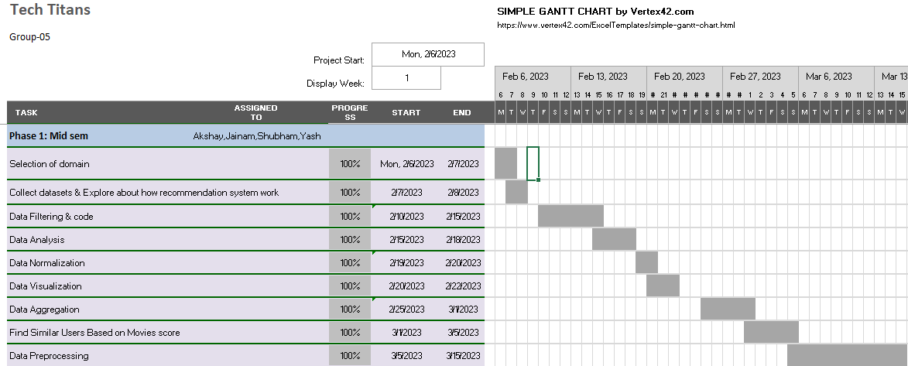
GANTT chart showing the project progress

Slide 5
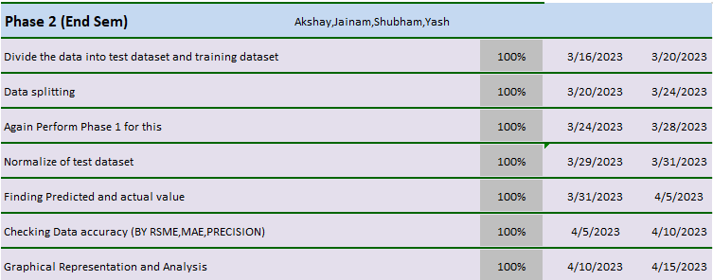

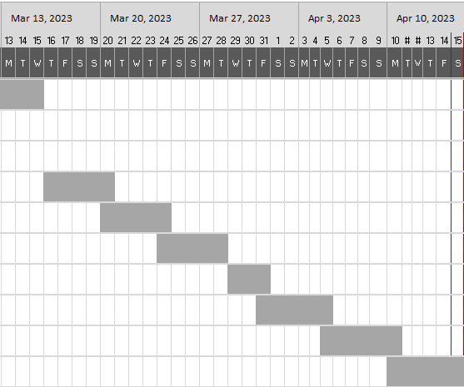

GANTT chart showing the project progress

Slide 6
The existing body of work
From the literature survey done on few research papers majority of the systems have used collaborating filtering. Filtering has been done using different algorithms like User KNN, Item KNN, Matrix Factorization, and SVD.
At many places Deep learning and Hybrid approaches are also used.
By analyzing the existing body of work, We can learn more about the various approaches and methods utilised to create recommendation systems.
[2] Lavanya, R., & Bharathi, B. (2021). Movie Recommendation System to Solve Data Sparsity Using Collaborative Filtering Approach. Transactions on Asian and Low-Resource Language Information Processing, 20(5), 1-14.
[3] Geetha, G., Safa, M., Fancy, C., & Saranya, D. (2018, April). A hybrid approach using collaborative filtering and content based filtering for recommender system. In Journal of Physics: Conference Series (Vol. 1000, No. 1, p. 012101). IOP Publishing.

Slide 7
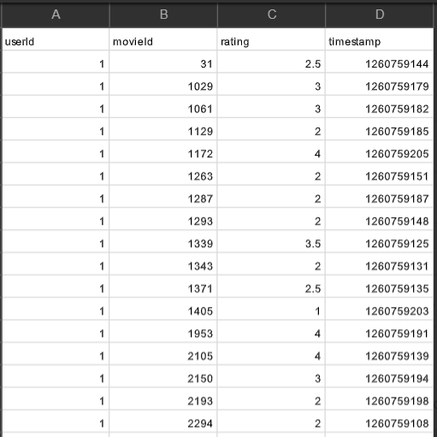
Dataset Information
We used ratings_small.csv and movies_metadata.csv files from the dataset for this project.
From movies_metadata.csv we used only movieId column.
By using this dataset we are having data of 671 different users, 9066 unique movies and 10 unique ratings.
[5] https://www.kaggle.com/datasets/rounakbanik/the-movies-dataset?select=movies_metadata.csv

Slide 8

Our Approach
Step 1 : Imported necessary libraries and loaded the movies and ratings data.
Step 2 : Aggregated ratings by movie and keep only movies with over 10 ratings.
Step 3 : Split the data into training and testing sets with an 70-30 split.
Step 4 : Created a user-item matrix for training dataset and normalized it.
Step 5 : Calculated user-user similarity using Pearson correlation and cosine similarity for training dataset.

Slide 9

Our Approach (Continued)
Step 6 : Found similar users based on user-user similarity and calculated the movie score for each movie by using similar user and movie rating.
Step 7 : Using movie score found predicted ratings and recommend top movies to the target user.
Step 8 : Using test dataset analyzed predicted and actual value.
Step 9 : Calculated entities like RMSE, MAE and Precision to find the Average Precision.
Step 10 : Plotted different scatter plots to analyze and understand the model properly.

Slide 10
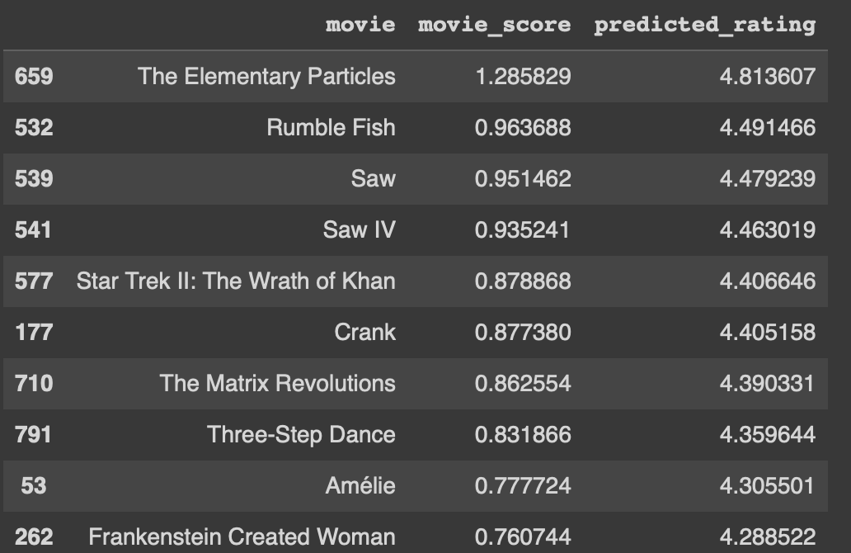
Final Results
Founded out the average rating for particular user
Founded out the predicted rating for all movies (which we had recommended to a particular user) by calculating the movie score and the average rating.

Slide 11
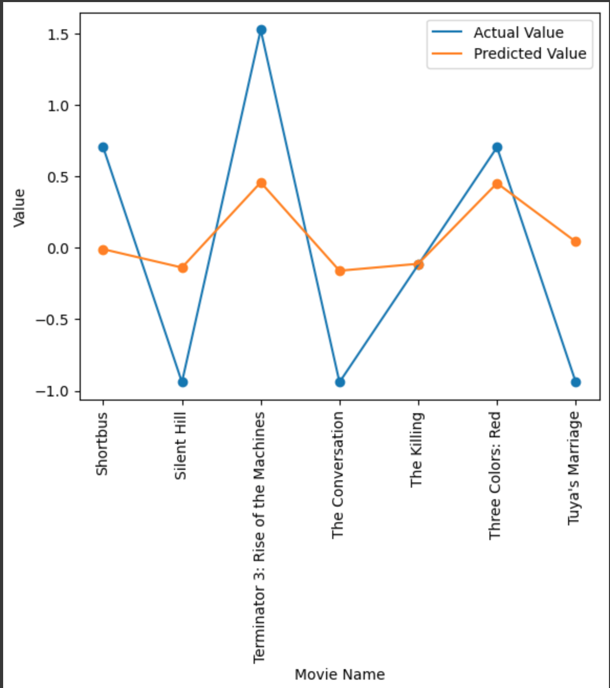
Final Results
Made a scatter plot for the actual rating value and the predicted rating value and then analyzed it.

Slide 12
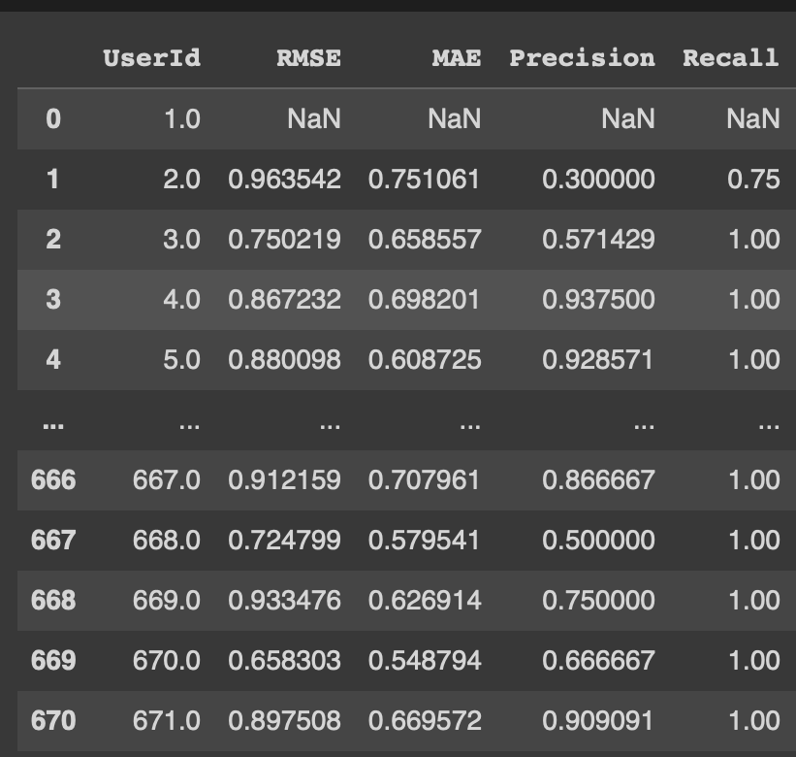
Final Results
For particular user rmse, mae and then precision founded.
Founded rmse,mae and precision for all users and then made a matrix shown in the image.

Slide 13
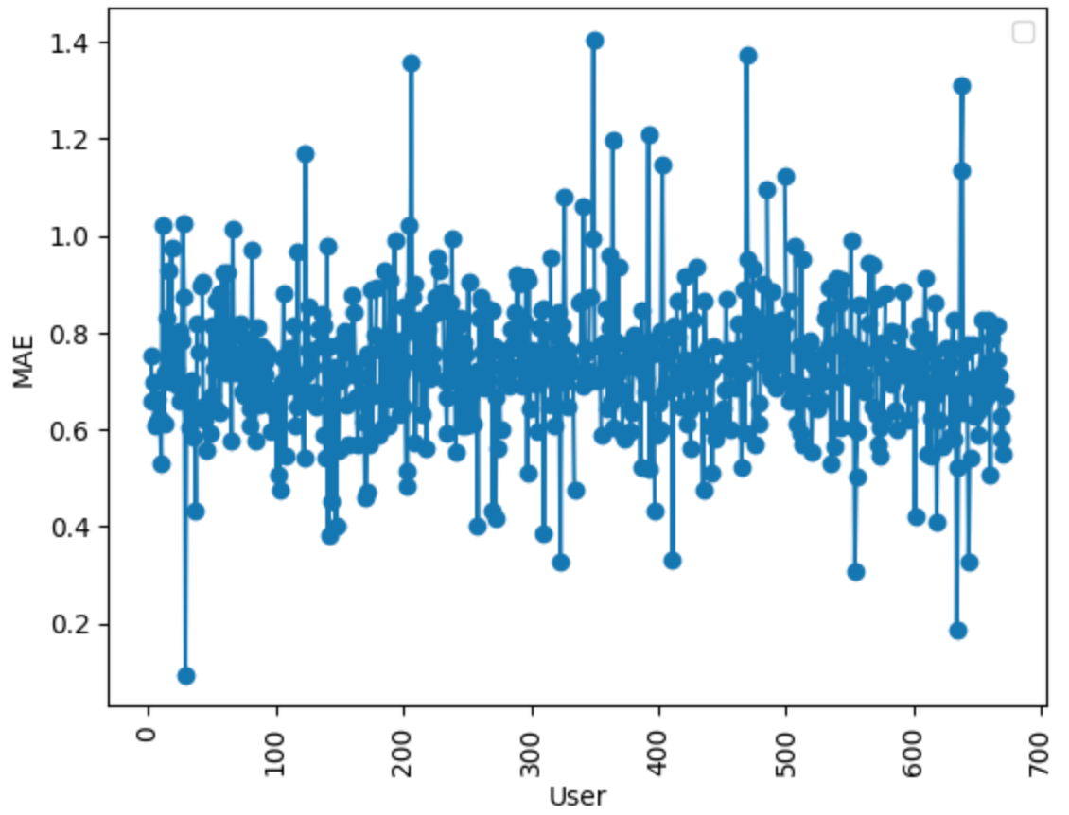
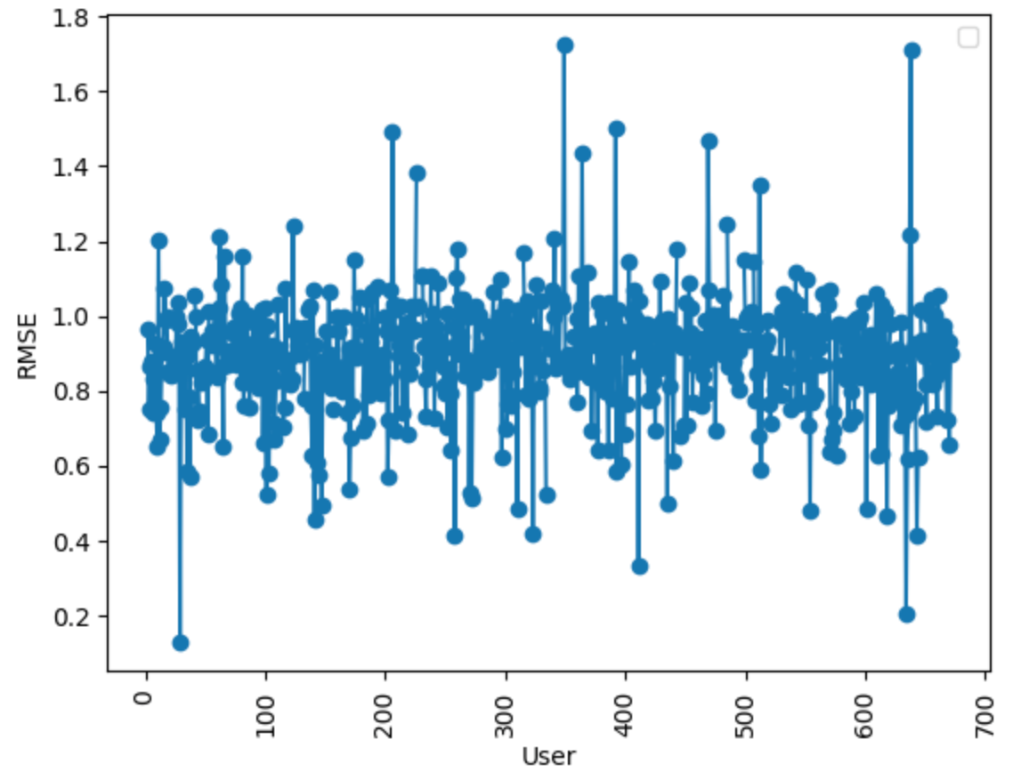
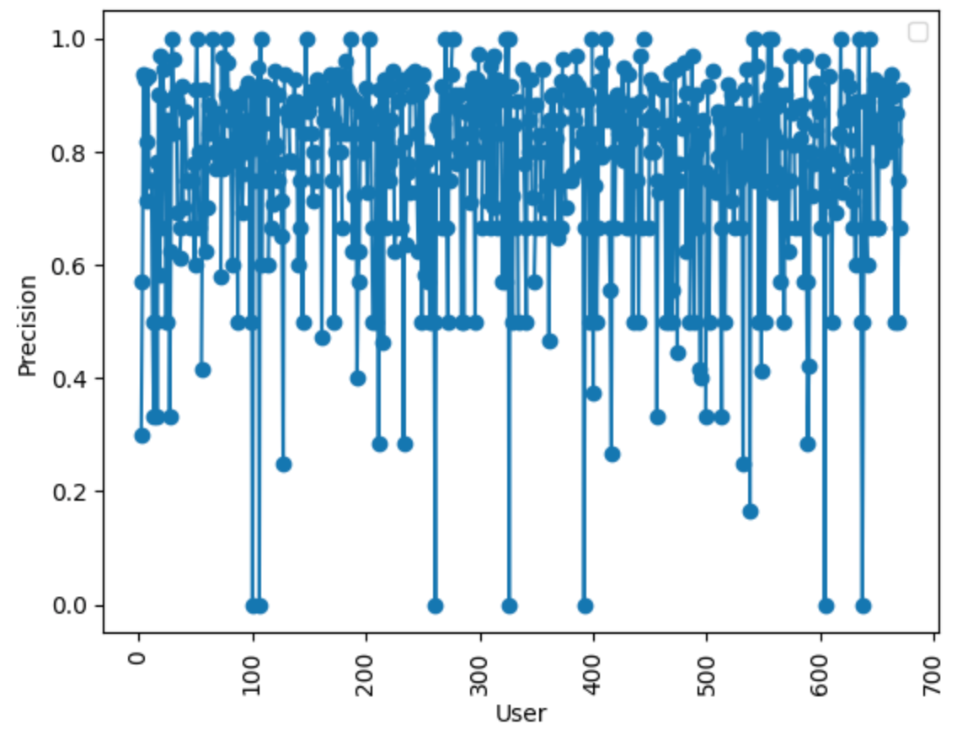
Final Results
MAE
RMSE
Precision

Slide 14
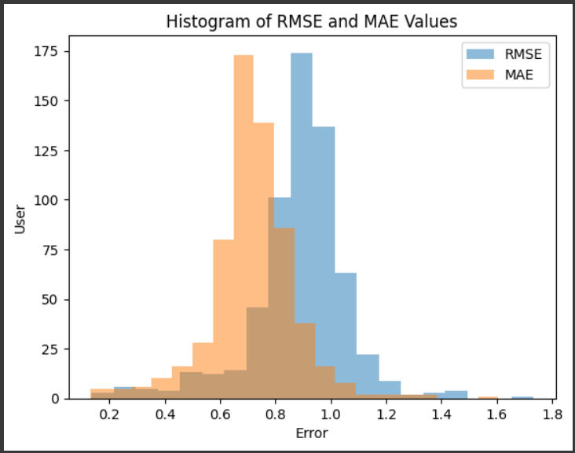
Final Results
Created a histogram for RMSE and MAE values and as per it tried to analysed it for the accuracy of the model.

Slide 15
Conclusions
At last, we can recommend a movie to users based on their preferences and movie ratings.
Checked the accuracy of the model.
We found that we got an accuracy of about 85% for the particular users.
For overall model accuracy, on an average we get about 80%.

Slide 16
Role of each group member in the project
Jainam R Shah: Final Results and Model Implementation
Yash Chotaliya : Model Implementation and Accuracy testing
Akshay Parmar : Data Visualization and Data Normalization
Shubham Bhatt : Final Results and Accuracy Testing

Slide 17
References
[1] Wu, C. S. M., Garg, D., & Bhandary, U. (2018, November). Movie recommendation system using collaborative filtering. In 2018 IEEE 9th International Conference on Software Engineering and Service Science (ICSESS) (pp. 11-15). IEEE.
[2] Lavanya, R., & Bharathi, B. (2021). Movie Recommendation System to Solve Data Sparsity Using Collaborative Filtering Approach. Transactions on Asian and Low-Resource Language Information Processing, 20(5), 1-14.
[3] Geetha, G., Safa, M., Fancy, C., & Saranya, D. (2018, April). A hybrid approach using collaborative filtering and content based filtering for recommender system. In Journal of Physics: Conference Series (Vol. 1000, No. 1, p. 012101). IOP Publishing.
[4] Anwar, T., & Uma, V. (2021). Comparative study of recommender system approaches and movie recommendation using collaborative filtering. International Journal of System Assurance Engineering and Management, 12, 426-436
[5] https://www.kaggle.com/datasets/rounakbanik/the-movies-dataset?select=movies_metadata.csv

